Slide 1
Instrumental Methods of Chemical Analysis To identify new things-to through modern light on old facts Dr. Gunvant H. Sonawane Department of Chemistry, Kisan Arts Commerce and Science College, Parola Dist Jalgaon, MS, 425111

Slide 2
Analytical Chemistry: It is measurement science. Analytical chemist has to answer following questions
Q. What chemicals are present in a sample?
Qualitative Analysis
Q. At what concentrations are they present?
-Quantitative Analysis
Where are the chemicals in the sample?
• liver, kidney, brain, water, soil,
• surface, bulk

Slide 3
Qualitative Techniques
Quantitative Techniques
Combination of Color / Smell
Melt / Boiling Point,
Solubility
Wetting
Density
Hardness
Separation Techniques
Extraction
Distillation
Precipitation
Crystallization
Titration
Gravimetry
Colorimetry

Slide 4
Electroanalytical methods.
• Electrochemical reactions involve electron transfer (ET) processes at electrode solution interfaces. These ET reactions may be kinetically sluggish or kinetically facile depending on the details of the ET reaction and the nature of the electrode surface.
• Provided an analyte species exhibits electroactivity (can be oxidised or reduced) then it may be detected using the tools of electrochemistry.
• Thus, electrochemical methods may be split up into two major classes :
Potentiometric and Amperometric.
• In potentiometry the ET reaction is kinetically facile and we measure the potential of a Galvanic cell under conditions of zero current flow. The cell potential responds to changes in the activity of the analyte species present in the solution in a well defined manner described by the Nernst equation.
Indeed the cell potential varies in a linear manner with the logarithm of the
analyte activity.
• In amperometry the kinetics of the ET reaction will have to be driven by an applied potential and so we measure the diffusion controlled current flowing across the electrode/solution interface. This current is directly proportion

Slide 5
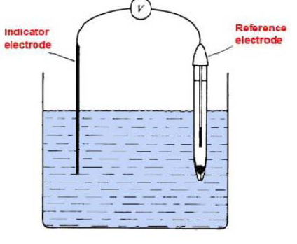
Basic Electrochemical Cell Two electrodes- Indicator electrode and Reference electrode

Slide 6
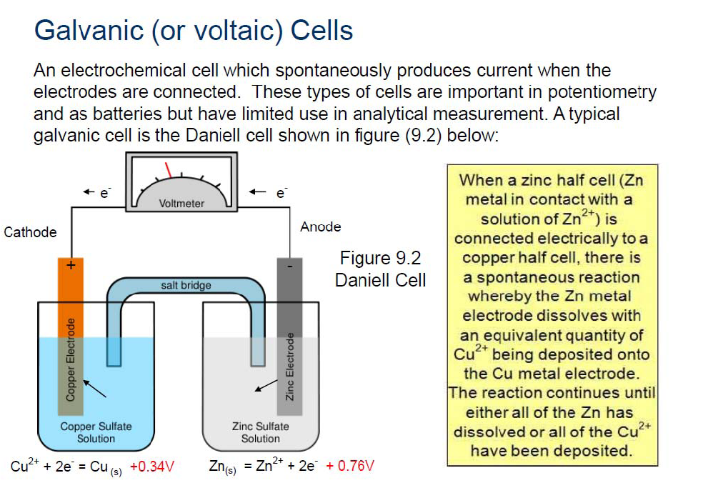

Slide 7
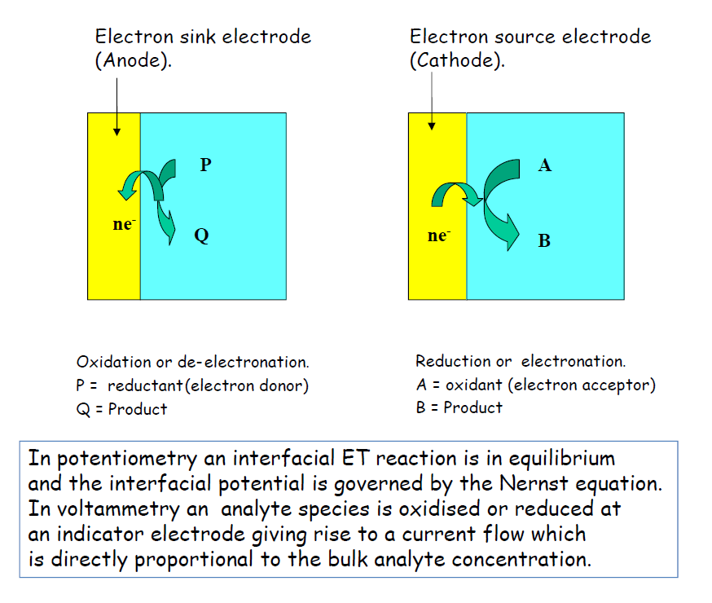

Slide 8
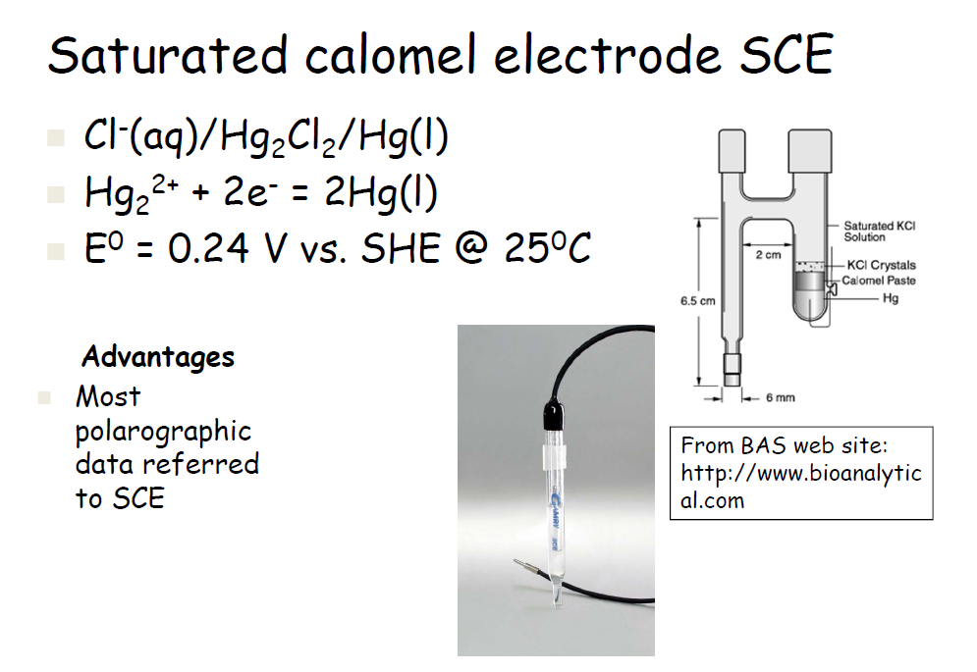
Reference Electrode-

Slide 9
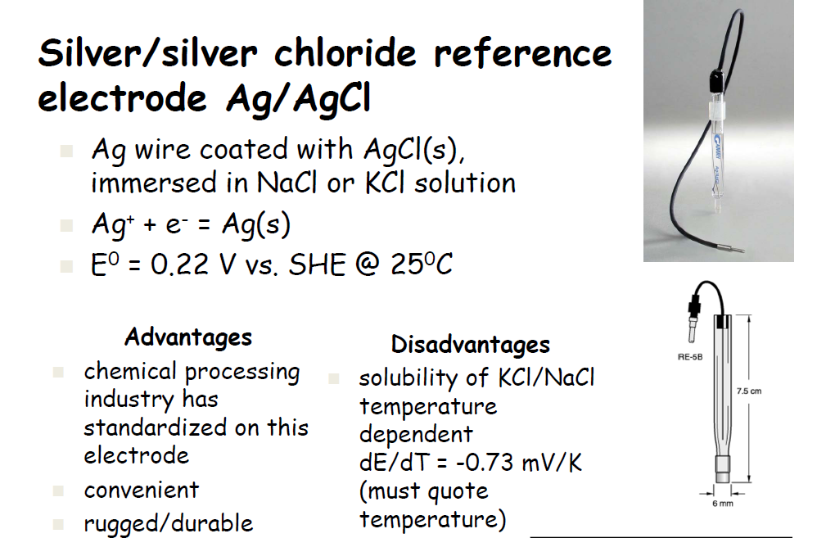

Slide 10
Chromatography – Chemical Separations
Different chemicals flow through separation medium (column or capillary) at different speeds plug of mixture goes in chemicals come out of column one-by-one (ideally)
Gas Chromatography GC
Powerful but Suitable for Volatile chemicals only
Liquid Chromatography High Performance (pressure),HPLC‟ in it‟s many forms –
Electrophoresis -Liquids, pump with electric current, capillary, gel, etc

Slide 11
Advantages:
To analyse a sample small amount of drug is enough.
Determination of qualitative and quantitative analysis in short time.
Complex mixtures can also be analysed with or without isolation.
It is with sufficient reliability and accurate.
Disadvantages:
Too costly.
Maintenance of instrument is difficult.
Chemical cleanliness is also costly.
Sensitivity depends on advancement of instrument there for upgrade it regularly.
Specialized test for handling or using is needed.
Frequent need of checking drugs is necessary therefore frequently check the instrument.

